Slide 1
Seminar 1: Autism Robot Simulation AI4
Supervised by: Dr. Abeer Mahmoud
T.A: Andrew Magdy

Slide 2
Team Members:
Antony Nabil Naguib Youhanna 20191703004
Alzahraa Mofed Mohammed Mofed 20191703001
Amira Barakat Ali Abdelwahab 20191703002
Nagwa Mohammed Anwar Ahmed 20191703037
Aya Khaled Mohammed Salah Elsayed 20191703005

Slide 3
Problem definition:
Autism is a condition that affects how a person thinks, feels, interacts with others, and experiences their environment. It is a lifelong disability that starts when a person is born and stays with them into old age.
Every Autistic person is different to every other. This is why autism is described as a ‘spectrum’.
People with Autism Spectrum Disorder (ASD) may behave, communicate, interact, and learn in ways that are different from most other people. There is often nothing about how they look that sets them apart from other people.
The abilities of people with ASD can vary significantly. For example, some people with ASD may have advanced conversation skills whereas others may be nonverbal. Some people with ASD need a lot of help in their daily lives; others can work and live with little to no support.
A child with ASD may:
Not want to be touched
Want to play alone.
Not want to change routines

Slide 4
Until recently experts talked about different types of autism which all now fall under the umbrella of autism spectrum disorder. However There is very little known about the causes of these disorders. these types are:
Asperger's syndrome. This is on the milder end of the autism spectrum. A person with Asperger's may be very intelligent and able to handle their daily life. They may be really focused on topics that interest them and discuss them nonstop. But they have a much harder time socially.
Pervasive developmental disorder, not otherwise specified (PDD-NOS). This diagnosis is a middle ground as it's given for those whose autism was more severe than Asperger's syndrome, but not as severe as autistic disorder. This older term is further along the autism spectrum than Asperger’s and PDD-NOS. It includes the same types of symptoms, but at a more intense level.
Childhood disintegrative disorder. This was the rarest and most severe part of the spectrum. It described children who develop normally and then quickly lose many social, language, and mental skills, usually between ages 2 and 4.

Slide 5
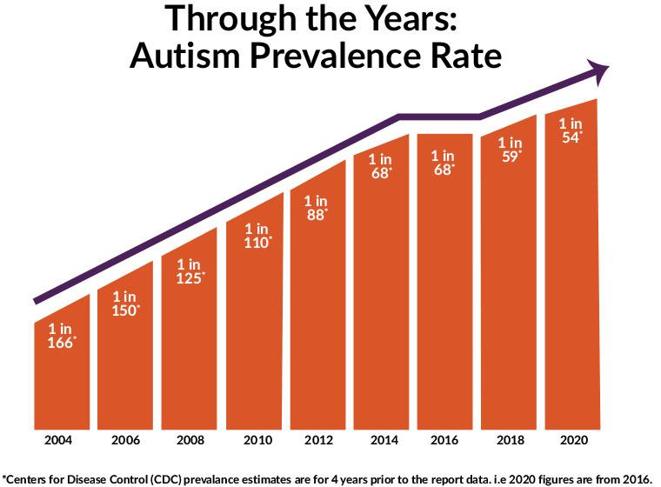
Motivation:
Autism Spectrum Disorders (ASDs) are characterized by impairments in social interaction, communication and behavioral functioning that can affect the health-related quality-of-life outcomes of the affected child and the family. ASDs have increased in prevalence, leading to a demand for improved understanding of the comparative effectiveness of different pharmacologic, behavioral, medical, and alternative treatments for children as well as systems for providing services.
1 in 44 (or 2.3%) of children in the US were identified with ASD using estimates from CDC’s Autism and Developmental Disabilities Monitoring (ADDM) Network. The 2021 prevalence estimate from data collected in 2018 is roughly 241% higher than estimates from 2000The last estimate, reported in 2020, showed 1 in 54 kids identified with ASD. A mere year later the reported estimate increased to 1 in 44*

Slide 6
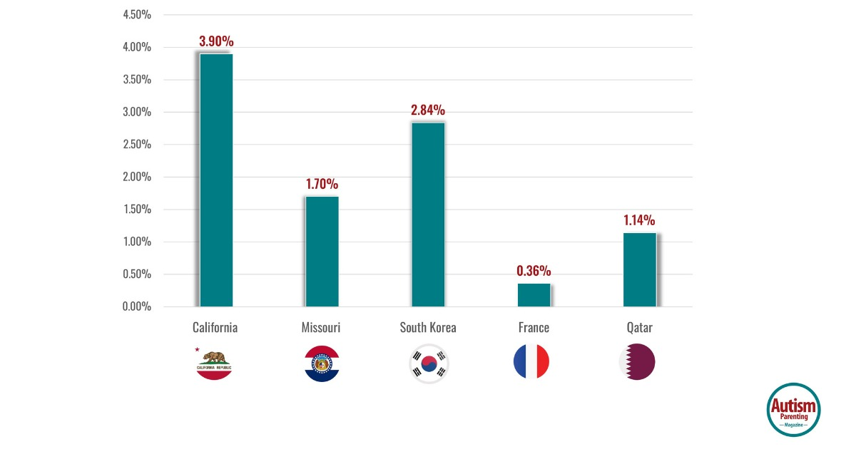
Research suggests autism rates vary greatly across countries—and even among states in the US—cultural. Examples include: California at 3.9%, Missouri at 1.7%, South Korea at 2.84%, France at 0.36%, and Qatar at 1.14%This variation is due to the fact that Many developing countries do not have reliable autism statistics due to a lack of resources. This means most autism research is from affluent, English-speaking countries

Slide 7
Research suggests around 40% of autistic children and adolescents have at least one of anxiety disorders. Roughly half of all children with ASD may also experience symptoms of ADHD Children on the spectrum are more likely than their peers to experience sleep, gastrointestinal, and weight management challenges. Children with ASD may also have an elevated risk of epilepsy. An estimated 90% of autistic individuals may have atypical sensory experiences. Individuals on the spectrum have a substantially heightened risk of dying from serious injury

Slide 8
Objective:
So, the aim of our Project is decreasing the percentage of autism for children and helping their families and people responsible for them by obtaining someone who sets and take care of these children for certain periods and make these kids gain some skills. This could occur by designing an application equipped with a screen showing some educational games. These games will allow children to do some exercises and improve the communication skills. Also, they aim to educate these children letters and some simple words in English. But they are not just any games, they are designed for kids who have autism and at the same time the application will be able to detect whether the kid is happy or sad and do actions based on that, also it will teach him the things in his surroundings and will try to communicate to him through voice. (design requirements/constraints)

Slide 9
Prior solutions:
Robota, keepon, kasper all of those are robot help autistic children to improve their skills. Based on our research, if our application where to be built into a robot the robot we are going to work on is currently manufactured by a company called LUXI in Luxembourg and, they made a robot called QTrobot and it has the main functions of our app but they sell the robot and the autism software by 67K LE and this is a very high cost compared to if we did the robot as the hardware part it will be maximum 20K.
Plus our application will be flexible to be installed on a robot screen or a console or converted to a mobile app or etc.

Slide 10
Work plan:
We contacted a therapist to know more about autism and what activities and games should be designed for children with autism spectrum disorders
We studied more about machine learning, deep learning, and computer vision algorithms.
We are going to work on the features and deliver them on time
Then we are going to collect all those features and test the whole system as an application by the help of an autistic kids center we are trying to contact right now.

Slide 11
Features:
Face recognition: to recognize the child and its face
Facial Expression Recognition: to know if the child is happy or not and deal with it by other features.
Object recognition: to make the child learn the objects around him
Speech to text: With this feature we will remove the need of keyboard and will be using voice of the kid to enter the name and status.
Body spinning Ball: In order to make the child more interactive we need to make him do some exercise, and we aim to achieve this by using the Spin Ball game.
Directions Game: to make the child more aware with the environment.
Alphabet Teaching Program: to teach the child the A B Cs ….
Numbers Teaching program: to teach the child numbers 1 2 3
Colors Teaching program: to teach the child the colors and make him aware with all things.
Prayer teaching program: to teach the child religion in a simple way.
Human emotions teaching program: to teach him the emotions and how to express his feelings.
Full body estimation and Poses Detection: 3D Human pose estimation is a computer vision task which uses multiple/simple, monocular/stereo camera to estimate the body points in 3 dimensions. This have enormous application ranging from human fall detection, crime investigation, sports etc.
All of these features will teach the child in an attractive and simple way and make him more interactive with the community. it can deliver predictable responses over and over. it repeat things and behave in a consistent way, which are highly important to helping children with autism learn better.

Slide 12
Software tools:
Programming language: Python
IDE: PyCharm
Packages: Cv2, pandas, numpy, pygame, keras, tensorflow, torch, tkinter, gtts

Slide 13
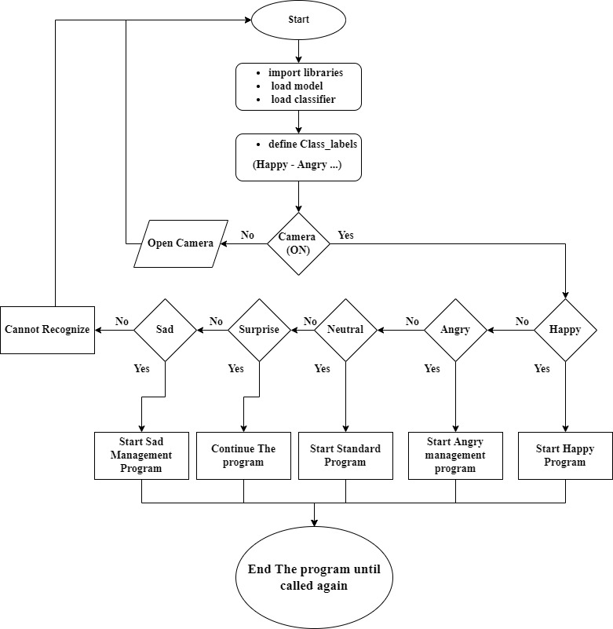
Software architecture: Facial Expressions flow graph

Slide 14
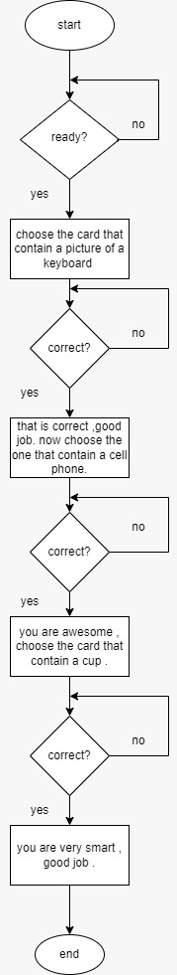
Software architecture: flowchart of card game

Slide 15
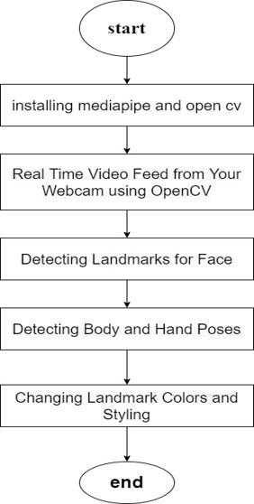
Software architecture: Body estimation flow graph

Slide 16
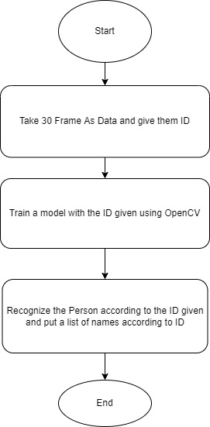
Software architecture: Face recognition flowgraph

Slide 17
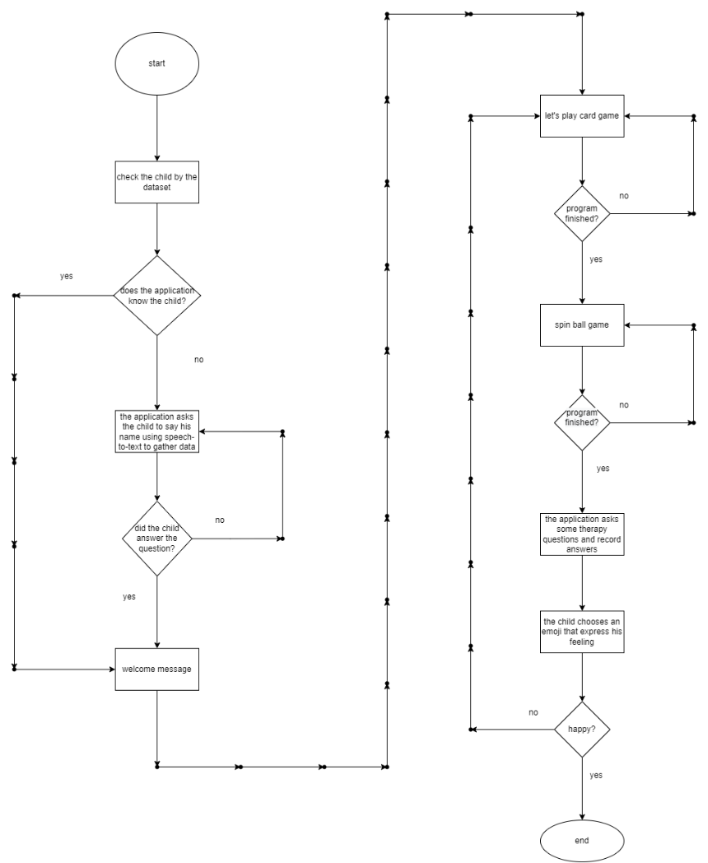
Software architecture: The system flowchart

Slide 18
References:
https://cpb-us-e1.wpmucdn.com/sites.psu.edu/dist/9/63617/files/2016/08/Submission-82-Design-Brief.pdf
https://www.youtube.com/watch?v=XfoYk_Z5AkI&list=PLfYUBJiXbdtSIJb-Qd3pw0cqCbkGeS0xn&index=7
A Brief History of Computer Vision (and Convolutional Neural Networks), Rostyslav Demush, Hacker Noon, February 27, 2019

